Slide 1
Object and Classes
JAVA OOP Concepets

Slide 2
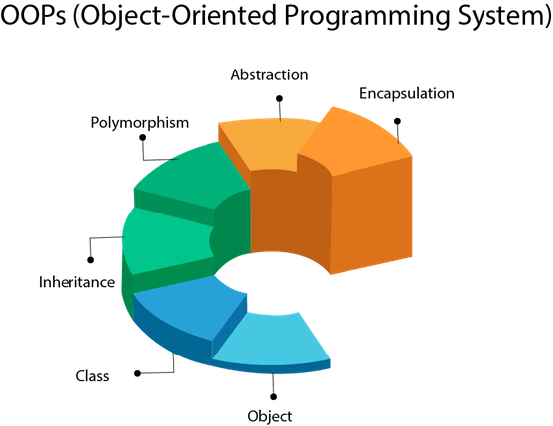
Java is an Object-Oriented Language. As a language that has the Object-Oriented feature, Java supports the following fundamental concepts −

Slide 3
Objects and Classes in Java
Objects : An entity that has state and behavior is known as an object e.g., chair, bike, marker, pen, table, car, etc.
Class : A class can be defined as a template/blueprint that describes the behavior/state that the object of its type support.

Slide 4
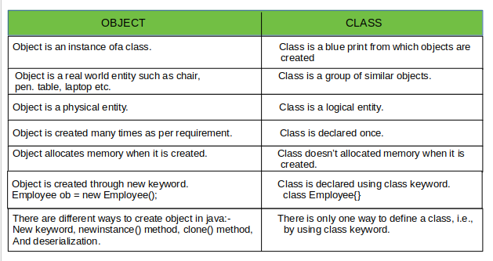
Object and Class different :-

Slide 5
Classes in Java
Example:
Public class man{
String breed;
String age;
String color;
void barking(){
}
void hungry(){
}
Void sleeping(){
}
}

Slide 6


